Slide 1
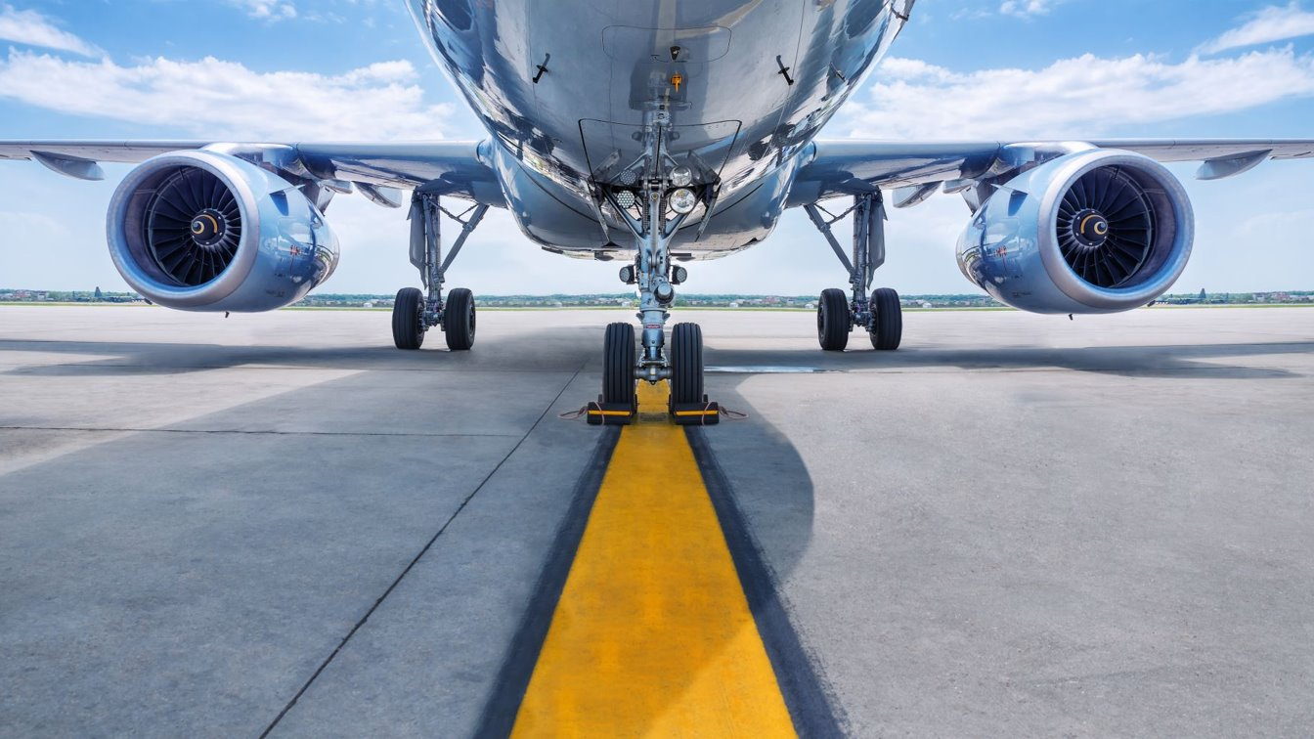
Boeing Case Competition Group #4
October 29th, 2021

Slide 2





Meet the Team
Aaron Singh
Senior
Major: Business Management
Nhan Tran
Junior
Major: Finance
Mark Applegate
Senior
Major: Supply Chain & Ops/ Business Management
Catherine Dao
Junior
Major: Information Systems
Richard Ramirez
Junior
Major: Finance
Notes:
My name is Richard Ramirez, and I am a Junior majoring in Finance!
We are excited to share with you, our presentation!

Slide 3
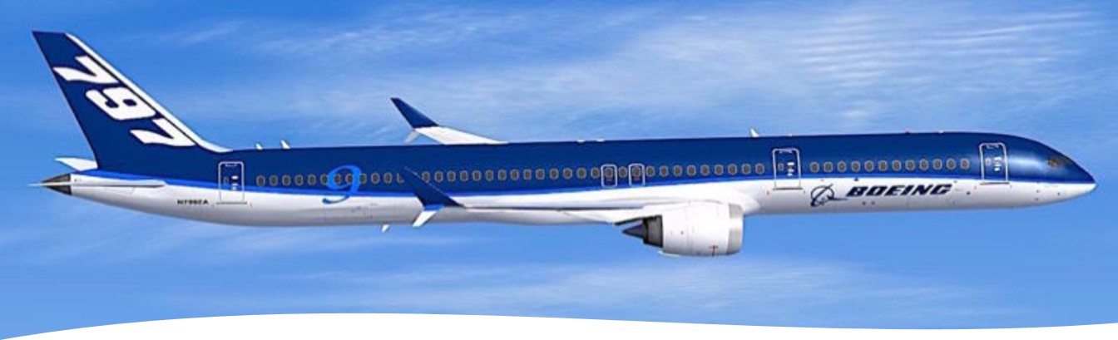
Agenda
Assumptions
Current State of Boeing
Our Recommendation
Market Trends
Financial Analysis
Performance Goals
Implementation Timeline
Risks and Considerations
Notes:
Slide 3
To start us off here is a quick view of our agenda for today!
Now to kick off our presentation I wanted to go over some assumptions we have made based on our research and after reviewing the case scenario.

Slide 4
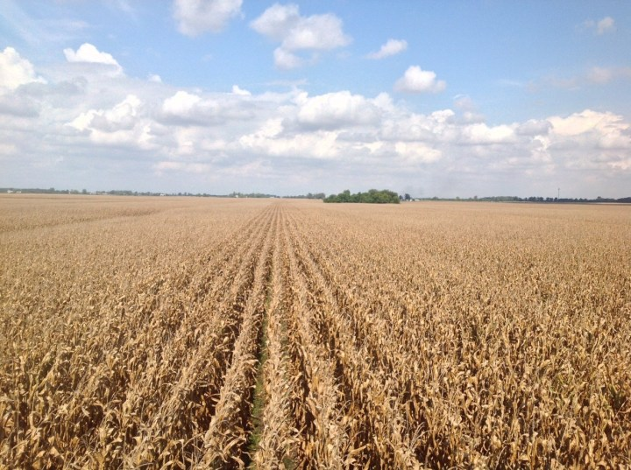
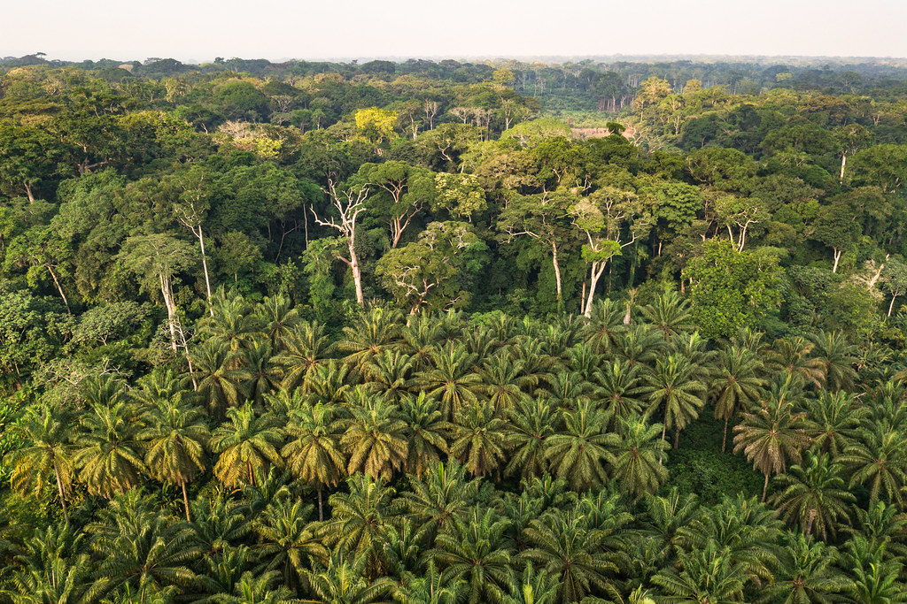
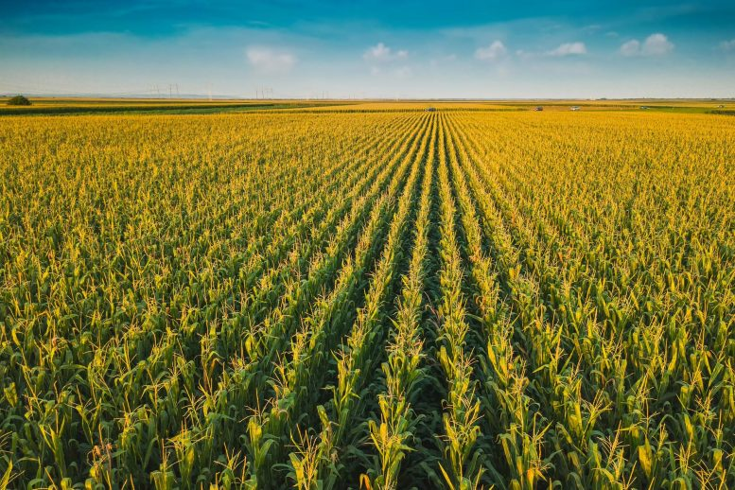
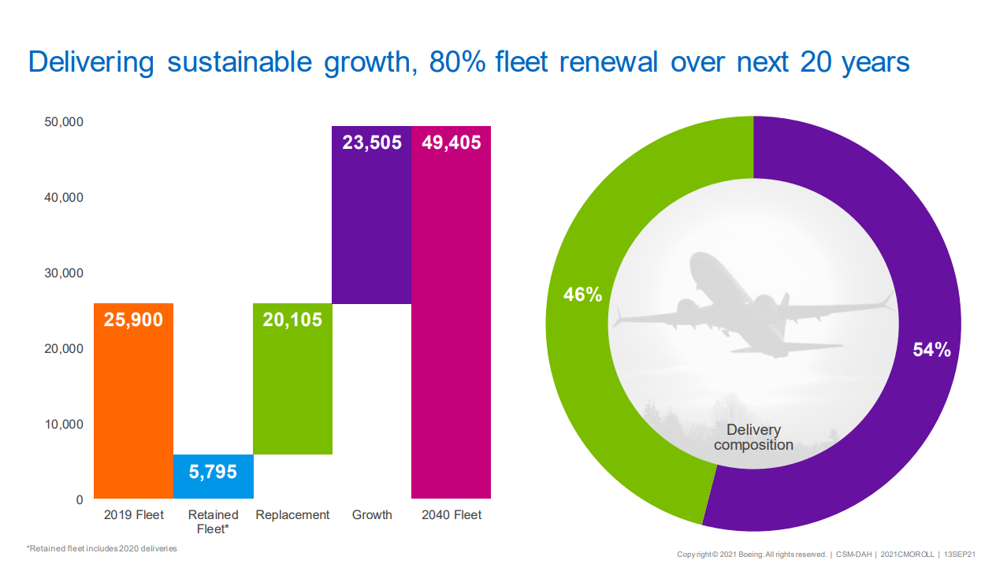
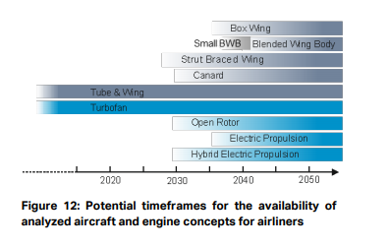
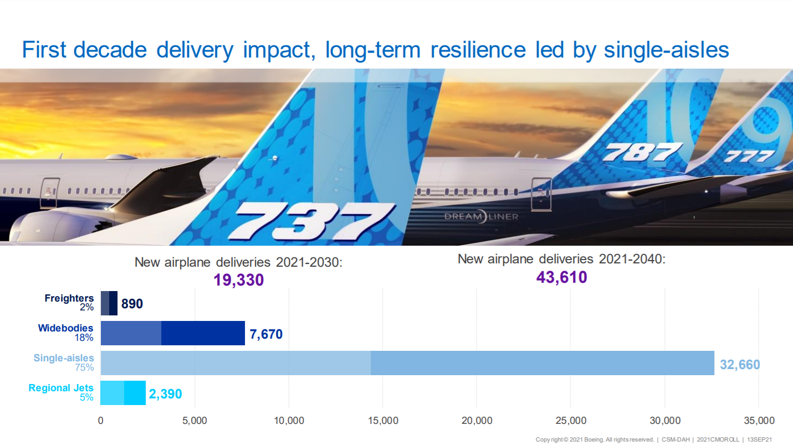
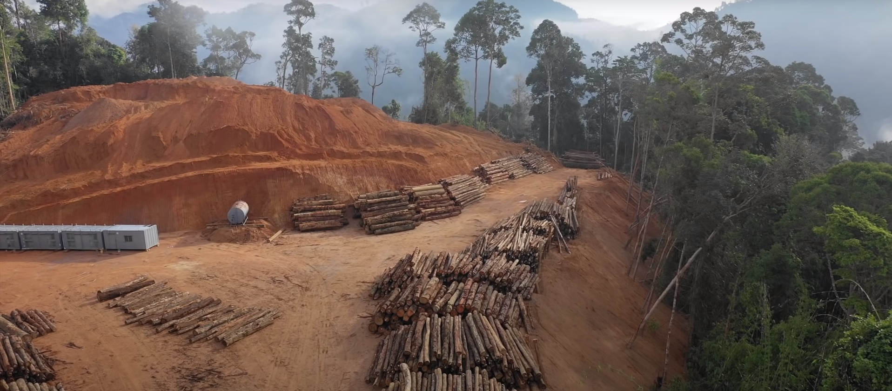
Assumptions
Reduce Carbon Emissions
Goal of project: Full – Electric Aircraft in the 2040’s
IATA technology projection
Hybrid- Electric Propulsion
Full-Electric Propulsion
Boeing’s Market Outlook
2040 Fleet Size: 49,405
75% of market is Narrow-Body, Single-Aisle
Sustainable Aviation Fuel is a short-term solution for a long-term problem
Boeing’s Capital Structure
Notes:
Slide 4
First, we believe globally, we have a common objective to reduce carbon emissions to save our planet.
With that in mind, our project has the end goal of having a full-electric aircraft in the 2040’s.
This table from the International Air Transport Association illustrates the potential timeframes for the availability of aircraft and engine concepts for airliners.
As you can see, Hybrid Electric Propulsion and Full- Electric technology is expected to be available approximately in the year 2030 and 2035, respectively.
Now based on Boeing’s Market Outlook, we assume that the fleet will grow to roughly 49 to 50 thousand aircraft in the 2040’s.
Of those aircraft in the 2040 fleet, 75% will be single-aisle Narrow to mid body aircraft.
Furthermore, with our research, we discovered that Sustainable Aviation Fuel, simply put, isn’t that sustainable.
Unless there is some innovation that allows us to produce SAF more efficiently, SAF’s are not scalable.
And lastly, we looked at Boeing’s debt situation.
What we concluded is…
With the current business transformation activities, and back-logged orders with a value estimated at $282 billion waiting to be fulfilled.
Boeing will restore its capital structure back to a respectable 85/15 debt-to-equity ratio within the next 5 years.

Slide 5
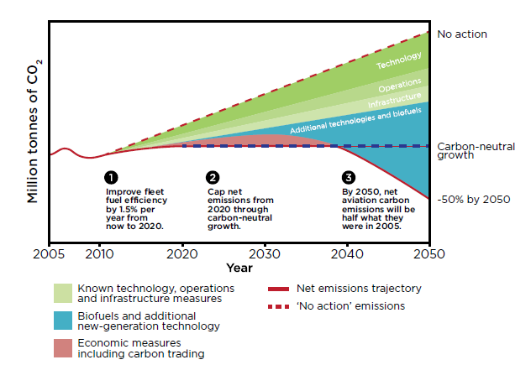
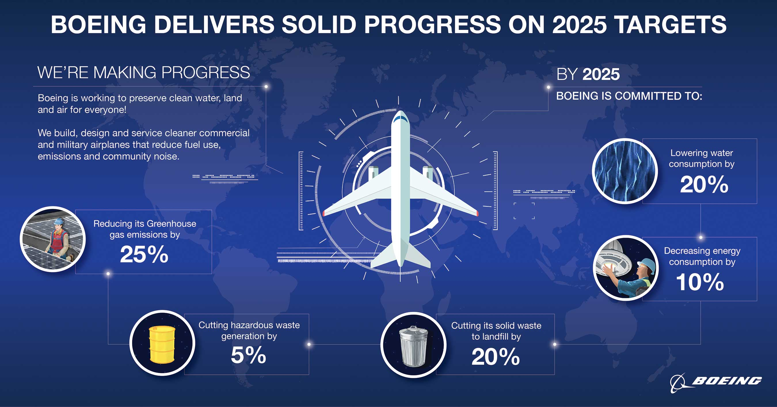
Boeing is Headed in the Right Direction
We recognize your recent sustainable efforts
Business Transformation Efforts
Net-zero carbon aviation sector by 2050
Notes:
Government is looking to have net zero-carbon aviation sector by 2050. The government is also trying to be producing at least 3 billion gallons of sustainable fuel per year by 2030. United Airlines announced their goal to reduce their carbon emissions intensity 50% by 2035 compared to 2019. Delta Airlines is committed to replace 10% of current jet fuel with SAF by 2030. DHL Express has pledged to use 30% SAF by 2030. Boeing has reduced their property size by 6 million sq.ft. Left graph is a graph from IRENE (International Renewable Energy Agency. Biofuels can be okay for the short term, however we would like to slowly taper away from using biofuels for environmental benefits in the longterm.

Slide 6
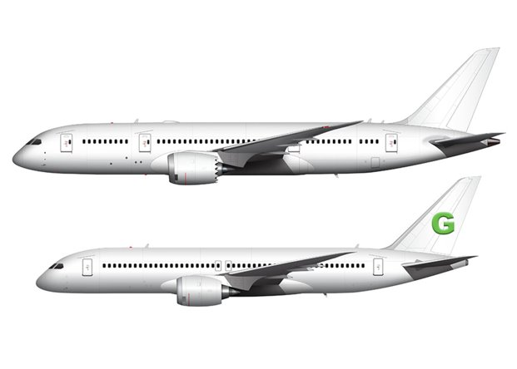
Our Recommendation:
797G
Single aisle midsize
50 Kerosene 50 SAF/Biofuel Blend
230 seats
10-12 hours range (5000nm or 9300km)
Direct competition with A321XLR
Replacement for 757
$200 million list price
Enter service in early 2028
Mandal, Bishal, et al. “Side View Templates of the Boeing 797 Concept.” Norebbo, https://www.norebbo.com/boeing-797-side-view/.

Slide 7
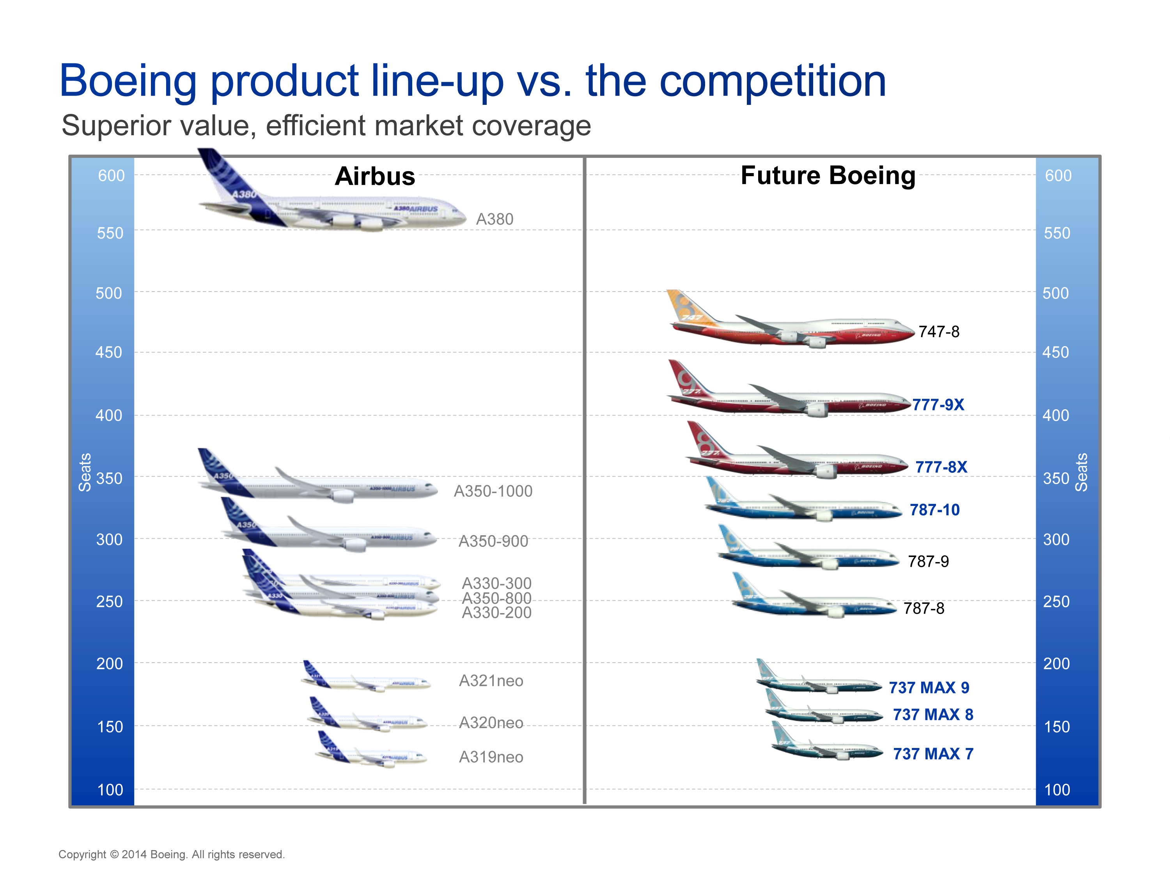
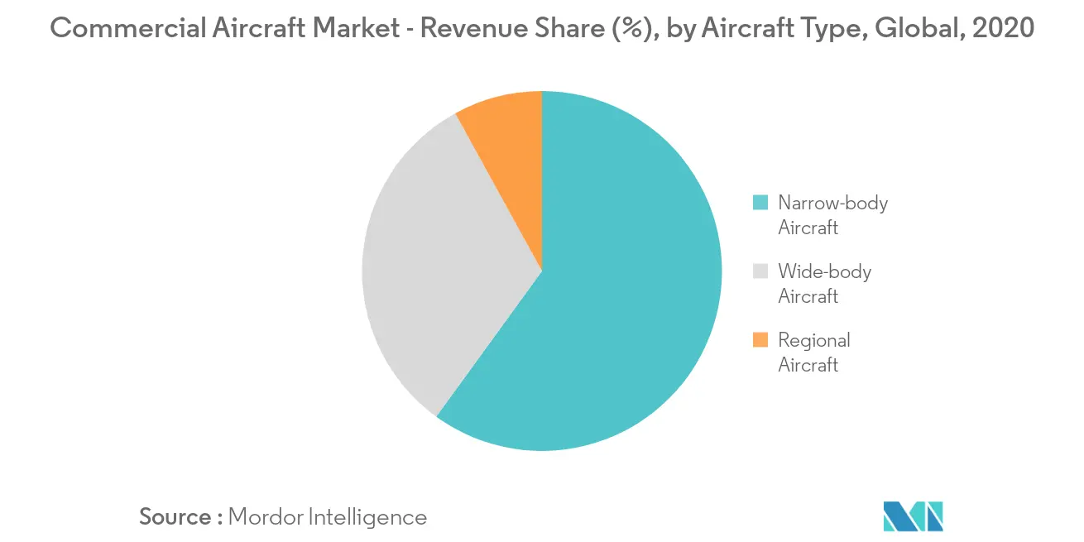
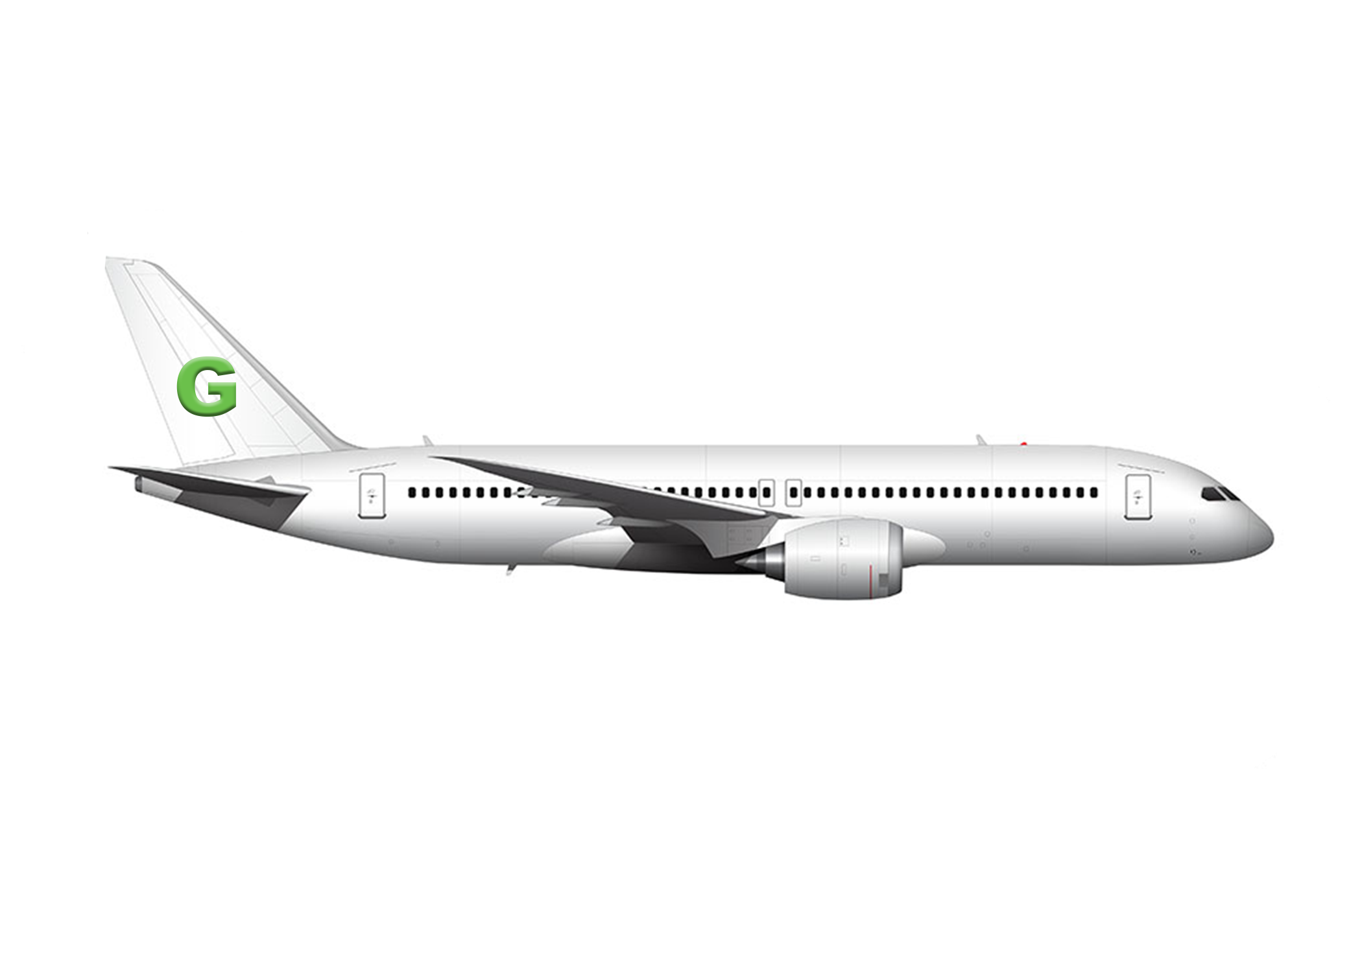
Market Trends
Narrow body predicted to grow to 65%-70% by 2031
Airbus controls 60% of Narrow Market
$7.2 trillion in predicted contracts through 2031
Boeing becomes strong competitor

Slide 8
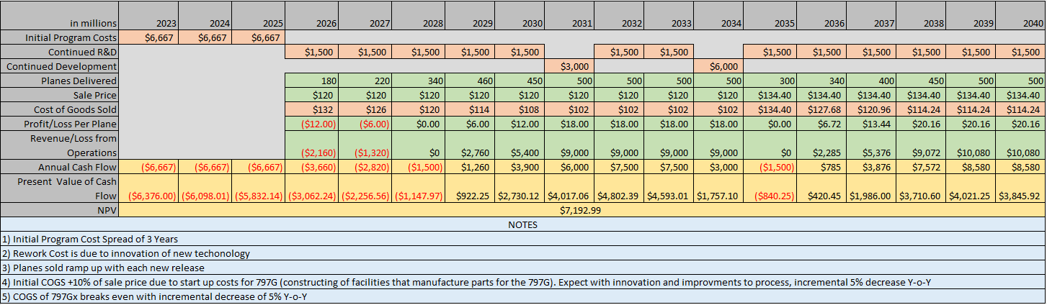
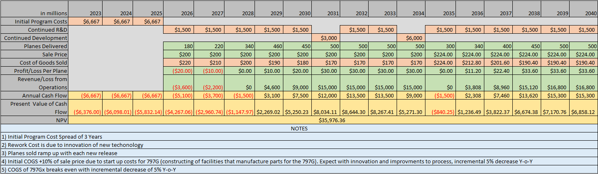
Financial Analysis of the 797G
40% Discount
Initial Project Costs:
Discounted List Price:
Profit Margin:
R&D Costs:
Cost of Innovation:
Net Present Value:
$20 Billion
$120 Million
15%
$1.5 Billion
Cost of New Facilities, Manufacturing of machines, new technology, etc.
No Discount
About $5.5 Billion
Notes:
Slide 6
Now for our financial analysis, we have two tables before us.
The table on top displays calculations with a 40% discount on our list price.
And for comparison, I provided the table on the bottom to illustrate the same calculations but without a discount
For starters…Based on the cost of the 787 project and considering much of the design of the 797G is based on the 787 design cues as Nhan had mentioned earlier,
We expect the Initial investment for the 797G to cost roughly $20 billion
As mentioned earlier, we discounted our $200 million list price by 40% thus making the discounted list price $120 million.
Operating with a 15% profit margin, our profit per unit is $18 million with a Cost of Goods sold of $102 million.
You might notice that the first couple of years of production, we are actually in a deficit. I will explain in a moment.
To calculate the net present value, we made a few assumptions…
Our R&D expenditure per year will be $1.5 billion dollars.
The cost of innovation are due to the cost of new or updated facilities, manufacturing of machines, new technologies, etc.
We assume that when we launch our future generations of the 797G’s, there will be a spike in cost attributed to the cost of innovation.
These costs will be estimated to be at $3 billion and $6 billion respectively.
Some of these costs from innovation will be seen in the cost of goods sold. Because we know there will be costs associated with the ramp up of production
As mentioned earlier the first couple of years, we will be operating in a deficit until we refine our production process.
Finally, for our financial analysis, we used net present value to see how the 797G will add benefit to Boeing’s current market value.
As you can see, our NPV calculation is about $7.2 billion.

Slide 9
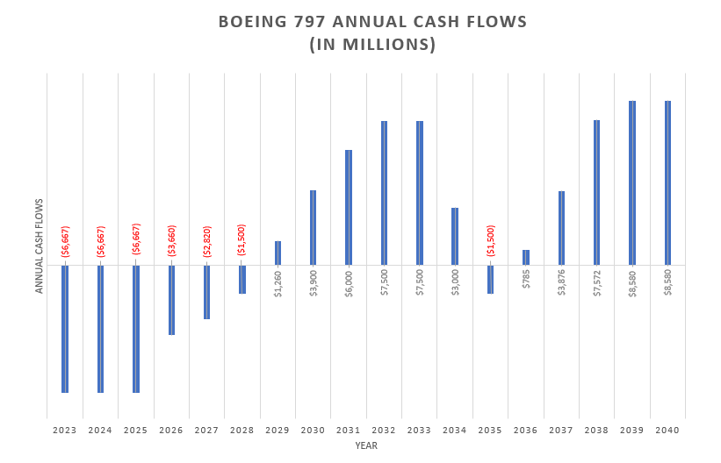
Payback Period: 11.2 Years
Notes:
This is a table of the Annual Cash flows of the 797 project.
Based on these numbers, the Payback period will be 11.2 years.
This may seem long, but bear in mind that the first three years are developmental years, and we don’t start production until the fourth year.
Lastly, with the only one deficit between 2029 and 2040 which is due to the launch of the 797GX,
Looking at the positive cash flows along with the current business transformation efforts mentioned earlier, we hope to further reduce Boeing’s debt prior to 2035

Slide 10





Implementation Timeline
2023: Announce 797G: Hybrid 50/50
Biofuel and Kerosene
2028: 797G Enter Service with Airline Partners
2031: Announce 797Gx Hybrid Biofuel and Electric
2035: 797Gx Hybrid Biofuel and Electric
2026:
797G First Flight & Certification Process
2029: Partnership with Battery Suppliers
2034:
Announce Full Electric Concept
2040's: Full Electric
2023 2024 2025 2026 2027 2028 2029 2030 2031 2032 2033 2034 2035 2036 2037 2038 2039 2040
2035: Airbus ZEROe Enter Service

Slide 11

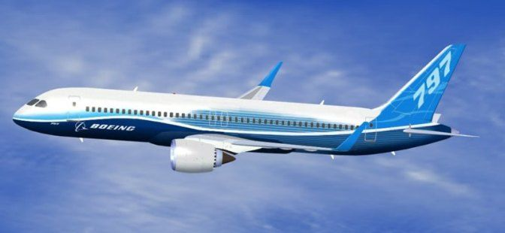
Performance: Goals & Measurements
First to market with Commercial Hybrid in 2028
"100% SAF" 2035 to compete against Airbus ZEROe
"Full-Electric" 2040's
Claim Narrow Body Market Share of at Least 30% by 2031
80 Debt 20 Equity by the end of 2034

Slide 12
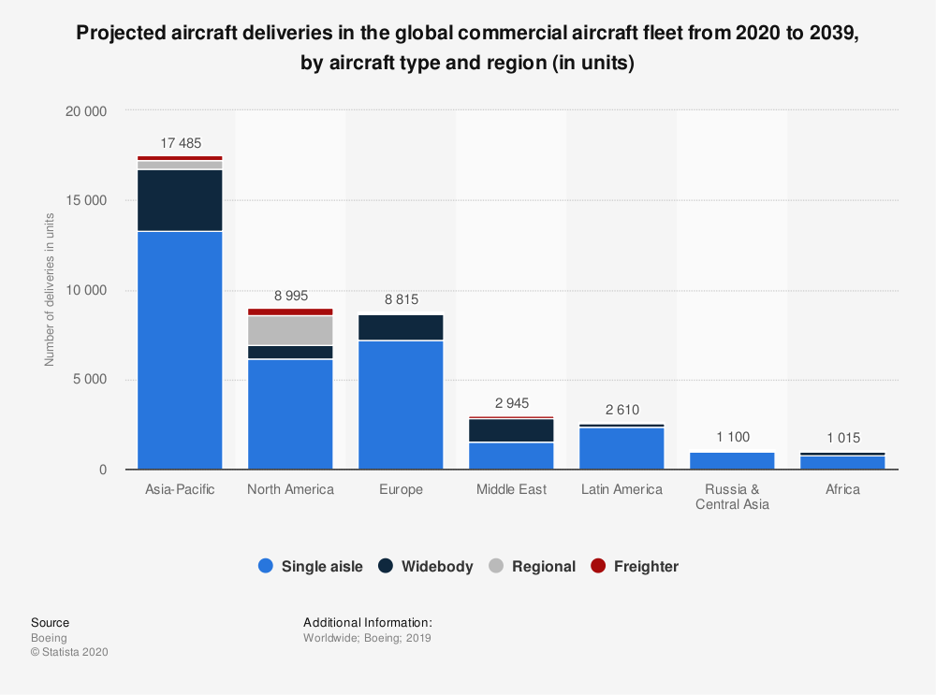
Risk & Considerations
Competing against Airbus in their Territory
Introducing an aircraft with 230 Seat Capacity
Global Markets – China
2nd Largest Aviation Market
Boeing China Delivery Centers

Slide 13

In conclusion...
Connect, Protect, Explore, and Inspire the world through aerospace innovation
Engineering Excellence | Accountability | Lean Principles | Eliminate Traveled Work | Reward Predictability and Stability
...and thank you for your time!
Notes:
This is a table of the Annual Cash flows of the 797 project.
Based on these numbers, the Payback period will be 11.2 years.
This may seem long, but bear in mind that the first three years are developmental years, and we don’t start production until the fourth year.
Lastly, with the only one deficit between 2029 and 2040 which is due to the launch of the 797GX,
Looking at the positive cash flows along with the current business transformation efforts mentioned earlier, we hope to further reduce Boeing’s debt prior to 2035

